Slide 1
UNIT 5 ImmunoBiology
Elements of the immune system,
Types of the immune response
Active and passive immunity
Immunoinformatics
epitope prediction tools

Slide 2
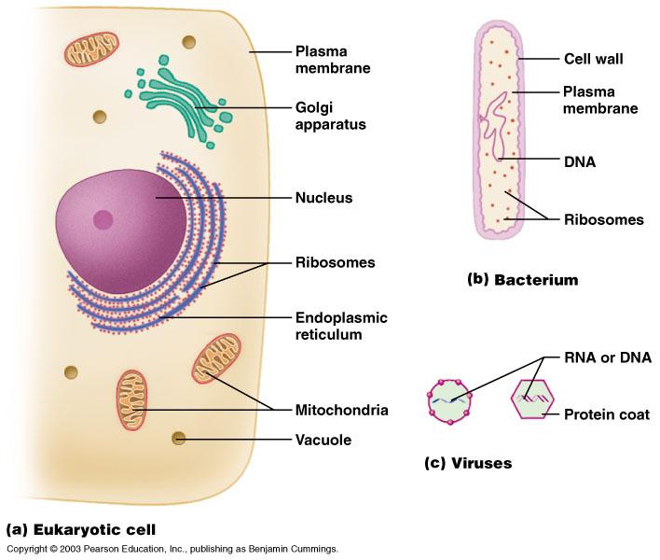
Eukaryotic Cells, Bacteria, and Viruses

Slide 3
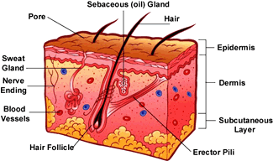
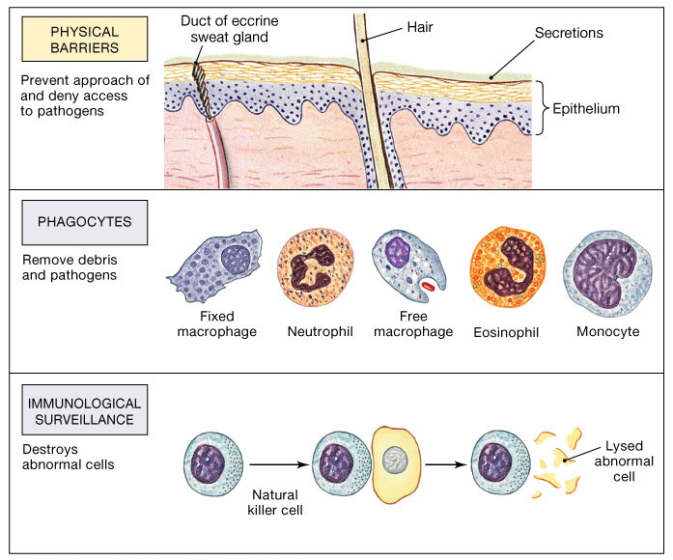
Body Defenses: Overview
Physical barriers: skin & epithelial linings & cilia
Chemical: acids, mucous & lysozymes
Immune defenses – internal
Innate, non-specific, immediate response (min/hrs)
Acquired – attack a specific pathogen (antigen)
Steps in Immune defense
Detect invader/foreign cells
Communicate alarm & recruit immune cells
Suppress or destroy invader

Slide 4
Discrimination of self from non-self
“The success of the immune system depends on its ability to discriminate between foreign (nonself) and host (self) cells. Survival requires both the ability to mount a destructive immune response against nonself and the inability to mount a destructive response against self.”

Slide 5
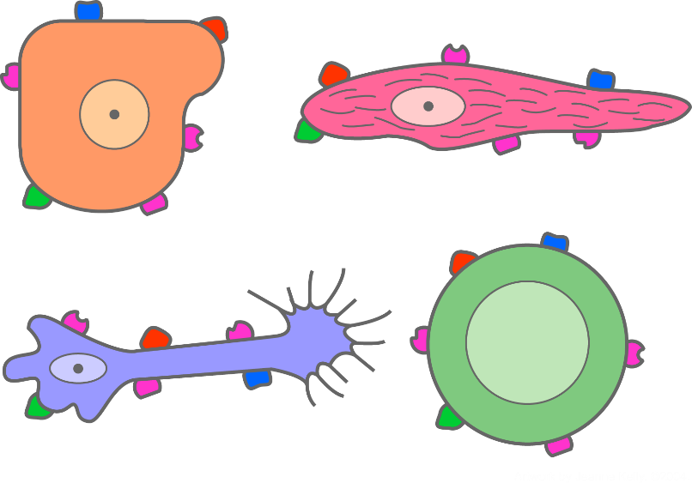
Markers of Self
Epithelial
cell
Muscle cell
Nerve
cell
Leukocyte
At the heart of the immune response is the ability to distinguish between “self” and “non-self.”
Every cell in your body carries the same set of distinctive surface proteins that distinguish you as “self.”
Normally your immune cells do not attack your own body tissues, which all carry the same pattern of self-markers; rather, your immune system coexists peaceably with your other body cells in a state known as self-tolerance.
This set of unique markers on human cells is called the major histocompatibility complex (MHC) proteins.
Notes:
5
At the heart of the immune response is the ability to distinguish between “self” and “non-self.” Every cell in your body carries the same set of distinctive surface proteins that distinguish you as “self.” Normally your immune cells do not attack your own body tissues, which all carry the same pattern of self-markers; rather, your immune system coexists peaceably with your other body cells in a state known as self-tolerance.
This set of unique markers on human cells is called the major histocompatibility complex (MHC) proteins. There are two classes: MHC Class I proteins, which are on all cells, and MHC Class II proteins, which are only on certain specialized cells.

Slide 6
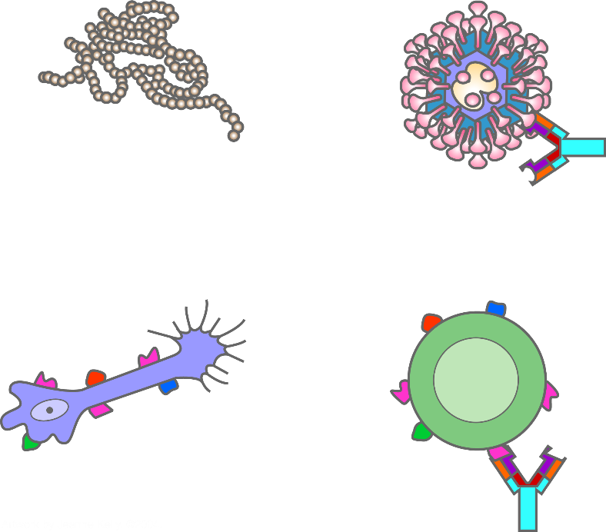
Markers of Non-self
Bacteria
SARS virus
Non-self leukocyte
Epitope
Non-self nerve cell
Antigen
Antigen = any non-self substance
Virus
Bacteria
Non-self cell (foreign cell)
Epitope = The distinctive markers on antigens that trigger an immune response
Notes:
6
Any non-self substance capable of triggering an immune response is known as an antigen. An antigen can be a whole non-self cell, a bacterium, a virus, an MHC marker protein or even a portion of a protein from a foreign organism.
The distinctive markers on antigens that trigger an immune response are called epitopes. When tissues or cells from another individual enter your body carrying such antigenic non-self epitopes, your immune cells react. This explains why transplanted tissues may be rejected as foreign and why antibodies will bind to them.

Slide 7
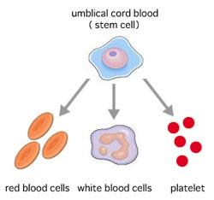
Blood
Blood is 55% liquid (plasma) and 45% cellular
Cellular component of blood:
Red blood cells = carry oxygen
White blood cells = immune system
Platelets = clot blood
All blood cells arise from a
pluri-potent stem cell found
in bone marrow
Stem Cell

Slide 8
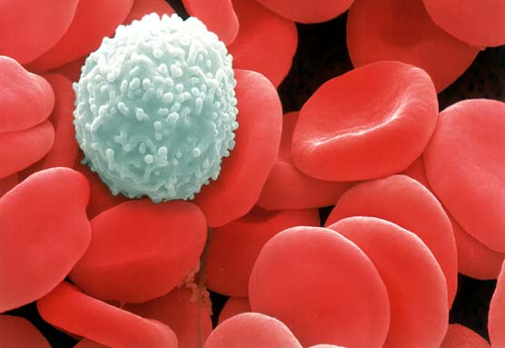
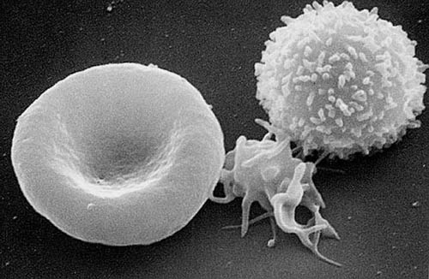
Blood cells
Red Blood cells
White blood cells (immune cells)
Platelets

Slide 9
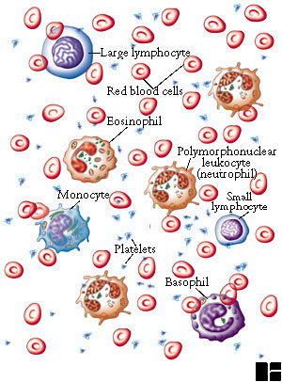
Leukocytes in the Blood
Red Blood Cells |  | 5.0 X 10⁶/mm³
Platelets |  | 2.5 X 10⁵/mm³
Leukocytes |  | 7.3 X 10³/mm³
1 | Neutrophil |  | 50-70%
2 | Lymphocyte |  | 20-40%
3 | Monocyte |  | 1-6%
4 | Eosinophil |  | 1-3%
5 | Basophil |  | <1%

Slide 10
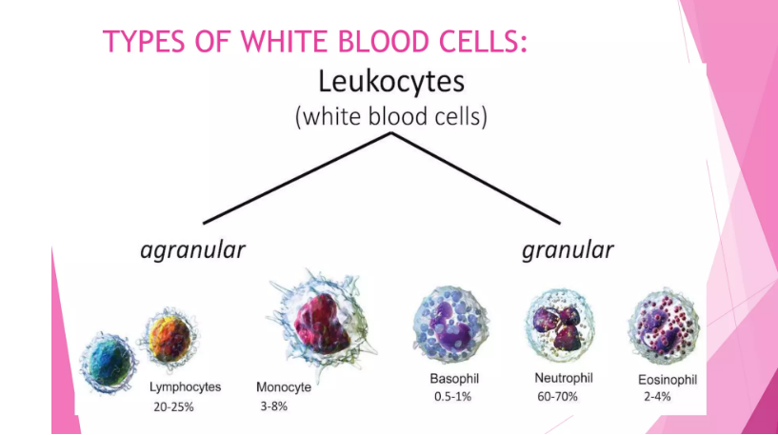

Slide 11
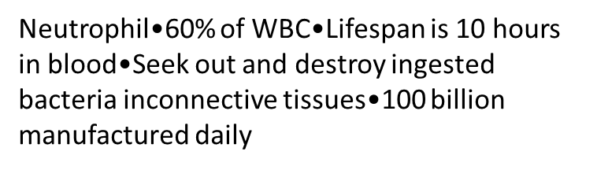
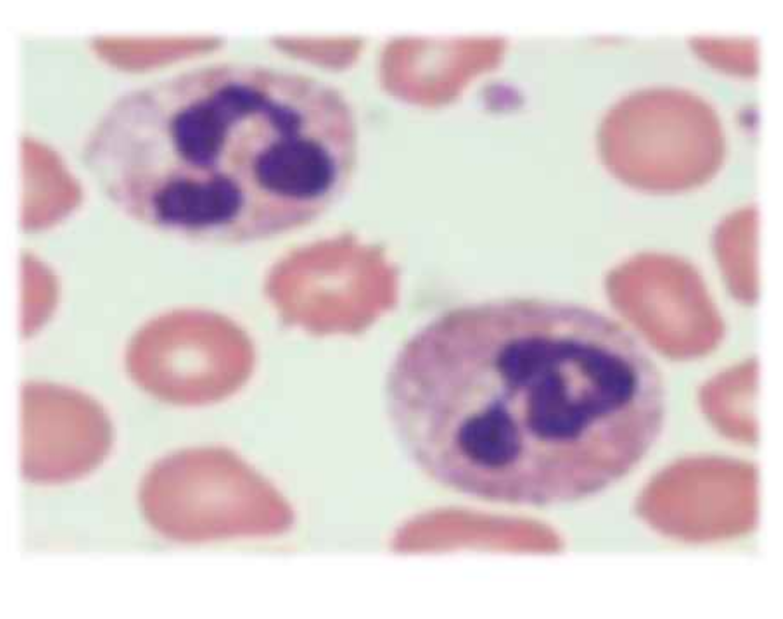
Neutrophil

Slide 12
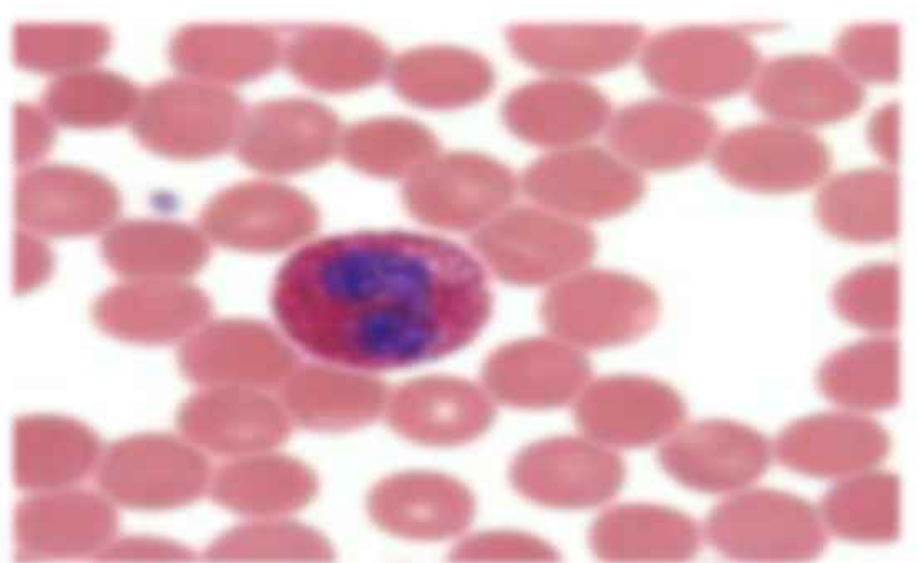
Eosinophil
1-3 % of WBC
Help control allergic reactions
Release an enzyme histamine – a chemical released during allergic reactions

Slide 13
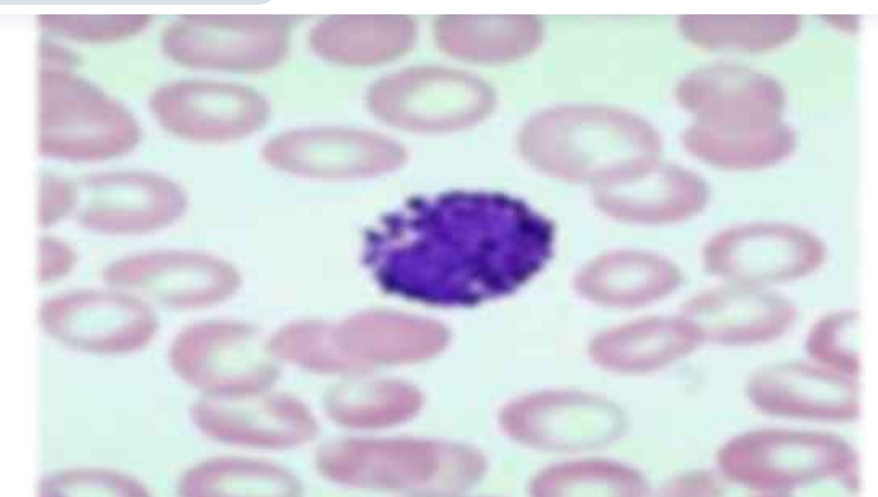
Basophil
Less than 1% of WBC
Involved in allergic and inflammatory reactions
Contains large amounts of histamines which may be released in injured tissue in order to increase inflammation
Contains heparin an anti-clotting chemical

Slide 14
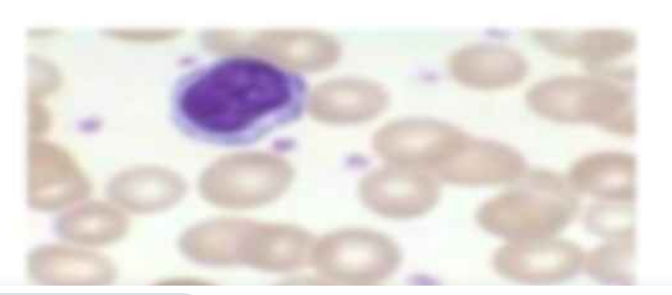
Lymphocytes
30% of all leukocytes
Made from stem cells, but are released from lymph nodes, thymus, spleen and bone marrow
Produce antibodies and destroy foreign cells found in infectious mononucleosis

Slide 15
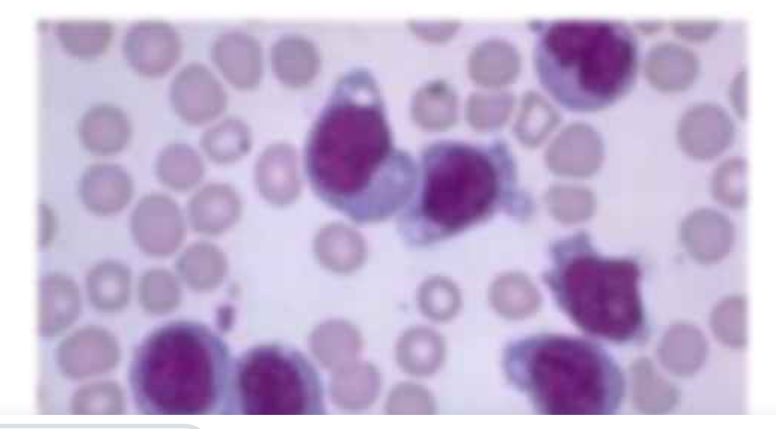
Monocyte
6% of WBC’s
Enter connective tissue
Eat bacteria, dead cells and other littering tissue

Slide 16
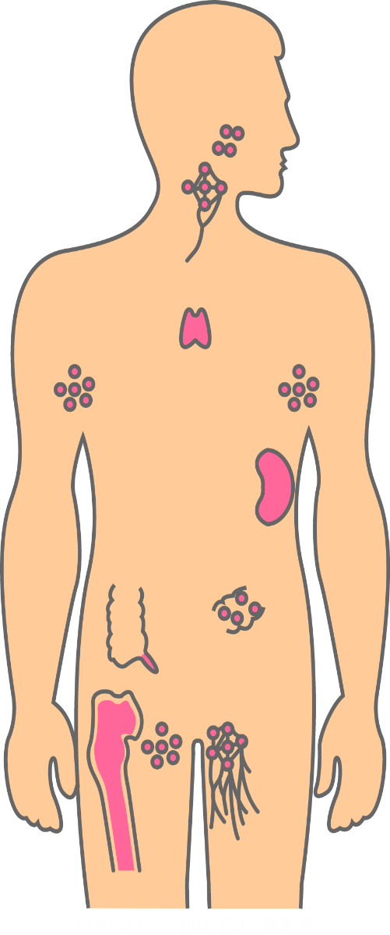
Organs of the Immune System
Tonsils and adenoids
Lymph nodes
Lymphatic vessels
Thymus
Lymph nodes
Spleen
Peyer’s patches
Appendix
Lymph nodes
Bone marrow
Lymphatic vessels
Bone marrow, the soft tissue in the hollow center of bones, is the ultimate source of all blood cells, including the immune cells.
Notes:
16
The organs of your immune system are positioned throughout your body.
They are called lymphoid organs because they are home to lymphocytes--the white blood cells that are key operatives of the immune system. Within these organs, the lymphocytes grow, develop, and are deployed.
Bone marrow, the soft tissue in the hollow center of bones, is the ultimate source of all blood cells, including the immune cells.
The thymus is an organ that lies behind the breastbone; lymphocytes known as T lymphocytes, or just T cells, mature there.
The spleen is a flattened organ at the upper left of the abdomen. Like the lymph nodes, the spleen contains specialized compartments where immune cells gather and confront antigens.
In addition to these organs, clumps of lymphoid tissue are found in many parts of the body, especially in the linings of the digestive tract and the airways and lungs--gateways to the body. These tissues include the tonsils, adenoids, and appendix.

Slide 17
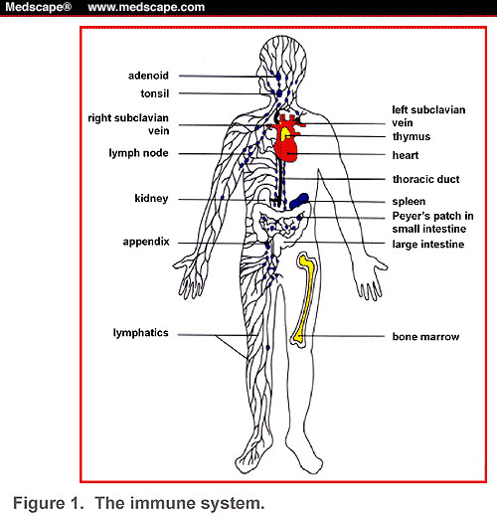
Lymphatic System
The organs of your immune system are connected with one another and with other organs of the body by a network of lymphatic vessels.
Notes:
17
The organs of your immune system are connected with one another and with other organs of the body by a network of lymphatic vessels.
Lymphocytes can travel throughout the body using the blood vessels. The cells can also travel through a system of lymphatic vessels that closely parallels the body’s veins and arteries. Cells and fluids are exchanged between blood and lymphatic vessels, enabling the lymphatic system to monitor the body for invading microbes. The lymphatic vessels carry lymph, a clear fluid that bathes the body’s tissues.

Slide 18
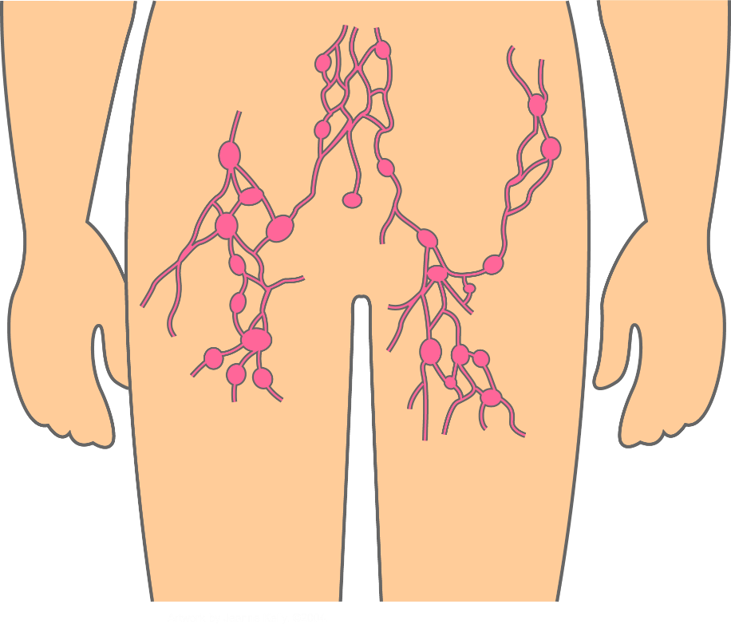
Lymphatic System
The organs of your immune system are connected with one another and with other organs of the body by a network of lymphatic vessels.
Lymphatic vessels closely parallels the body’s veins and arteries
Lymphatic vessels carry lymph, a clear fluid that bathes the body’s tissues
Cells/fluids are exchanged between blood and lymphatic vessels, enabling the lymphatic system to monitor the body for invading microbes.
2. Lymph nodes contain high levels of immune cells
Lymph node
Lymphatic vessel
Notes:
18
The organs of your immune system are connected with one another and with other organs of the body by a network of lymphatic vessels.
Lymphocytes can travel throughout the body using the blood vessels. The cells can also travel through a system of lymphatic vessels that closely parallels the body’s veins and arteries. Cells and fluids are exchanged between blood and lymphatic vessels, enabling the lymphatic system to monitor the body for invading microbes. The lymphatic vessels carry lymph, a clear fluid that bathes the body’s tissues.

Slide 19
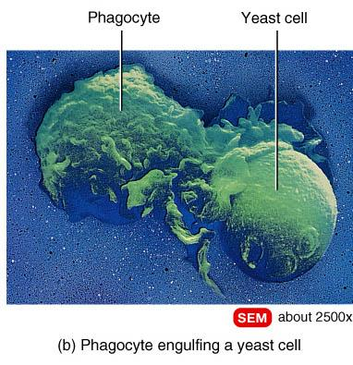
Nonspecific Defenses, Phagocytes
Remove cellular debris and respond to invasion by foreign pathogens
Monocyte-macrophage system - Fixed and free
Microphages – Neutrophils and eosinophils
Move by diapedesis
Exhibit chemotaxis

Slide 20
Nonspecific Defenses, Immunological surveillance
Constant monitoring of normal tissue by NK cells
NK cells
Recognize cell surface markers on foreign cells
Destroy cells with foreign antigens

Slide 21
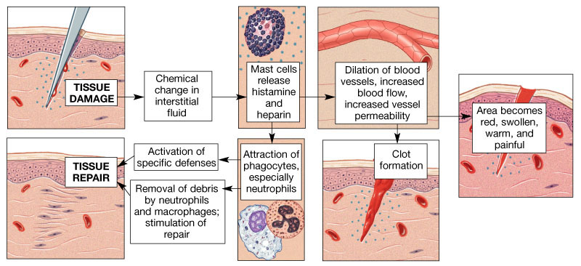
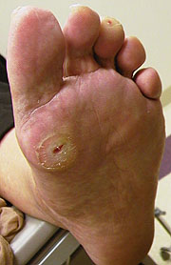
Inflammation
Diabetic foot ulcer

Slide 22
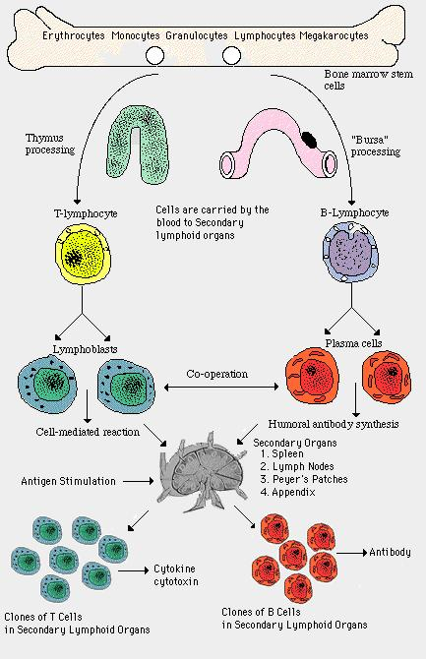
Adaptive or Acquired Immunity
Acquired after birth
Seen only in vertebrates
Characteristic features are:
Diversity
Specificity
Self vs non-self
Memory

Slide 23
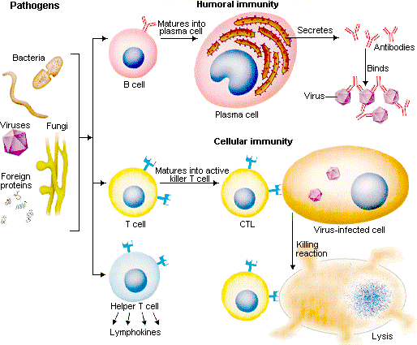
Immune Response System
Made up of two cellular systems (lymphocytes)
Humoral immunity - B cells
Cell-mediaed immunity - T cells
B cells make
antibodies
T cells mount
direct attack on
foreign/infected
cell

Slide 24
Cell mediated immunity
T cells must be activated
Must have both surface antigen recognition and costimulation to activate
T cell receptors recognise and bind to specific antigen presented with MHC complexes
T cell only activated if binds to antigen and receives costimulation
Co-stimulation provided by cytokines or membrane proteins
Need for co-stimulation prevents immune responses occurring accidentally
Recognition (binding to receptor) without costimulation results in anergy (prolonged state of inactivity) in both B and T cells
Once T cell co-stimulated it is activated
Proliferates
Differentiates (forms more highly specialised cells)
Activation, proliferation and differentiation occurs in secondary lymphatic organs and tissues

Slide 25
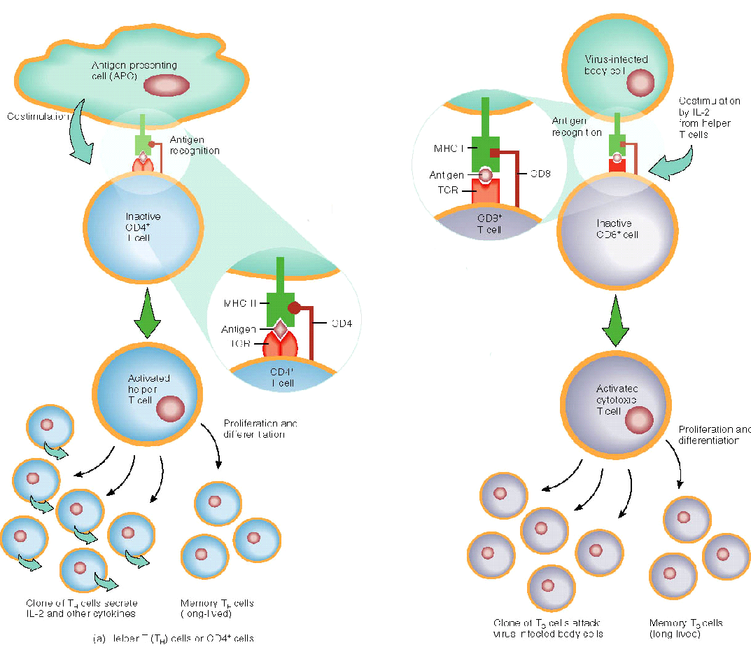

Slide 26
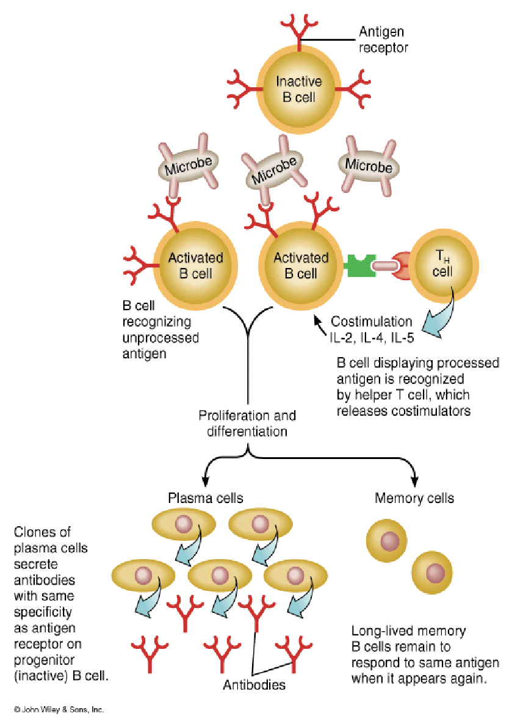
Humoral (Antibody-mediated) immunity
Mediated by B cells
Antigen can activate B cell in two ways:
direct binding
provokes less vigorous response
B cells process antigen (act as APC) and display processed antigen with MHC proteins
T_{H} cells recognise processed antigen
T_{H} cells provide co-stimulation for B cell
Activated B cell
proliferates and differentiates
plasma cells
secrete antibodies with same antigen binding properties as receptors
memory B cells

Slide 27
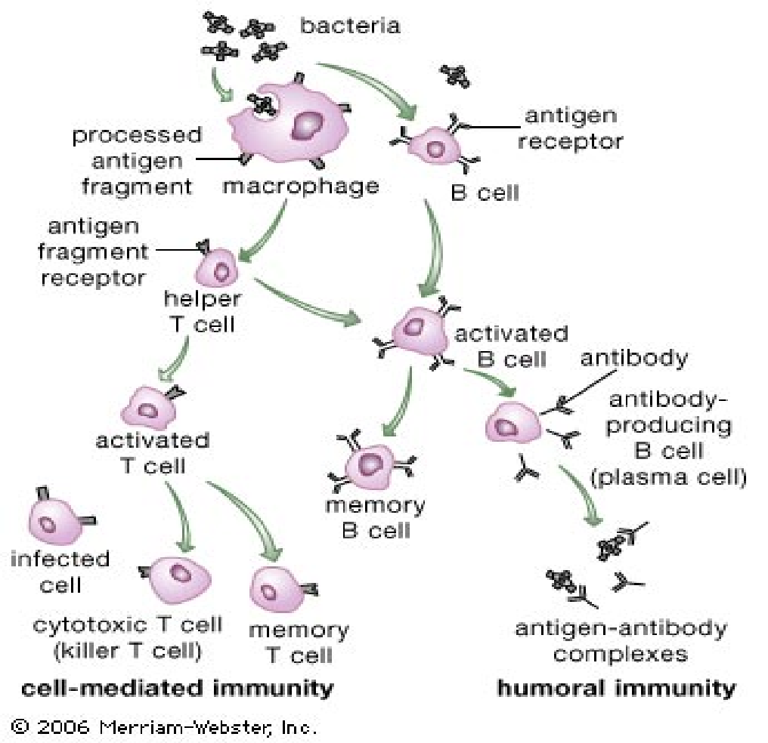
Summary of Acquired Immunity

Slide 28
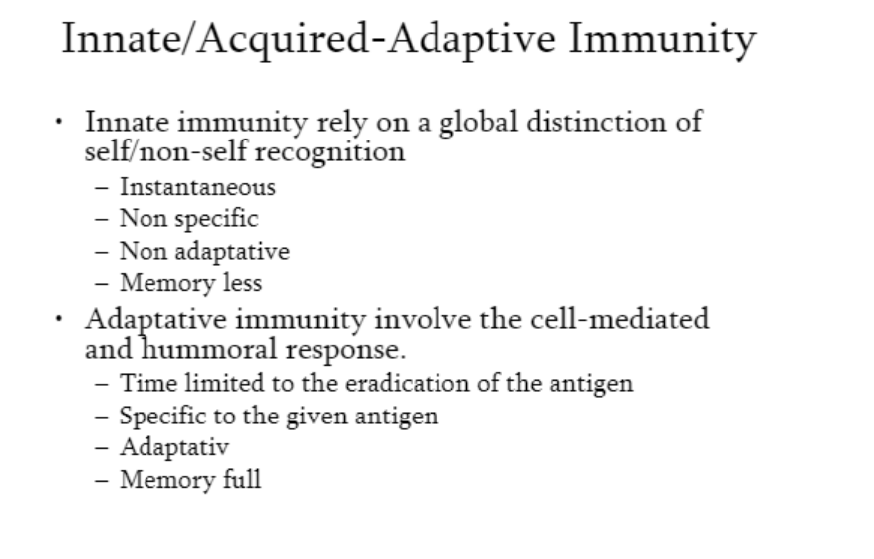

Slide 29
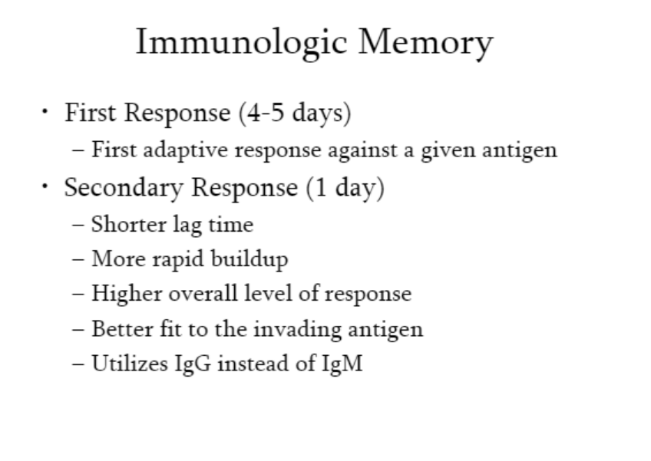

Slide 30
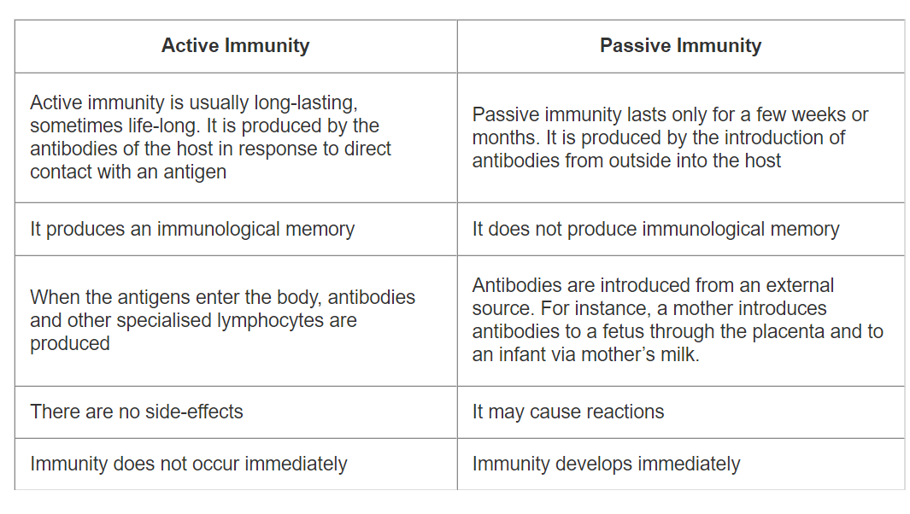
Active and Passive Immunity
Active immunity and passive immunity are two types of acquired immunity.

Slide 31
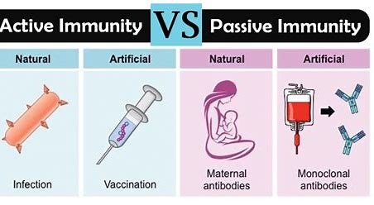
Immunity: Active and Passive
Notes:
31
Whenever T cells and B cells are activated, some become “memory” cells. The next time that an individual encounters that same antigen, the immune system is primed to destroy it quickly. This is active immunity because the body’s immune system prepares itself for future challenges. Long-term active immunity can be naturally acquired by infection or artificially acquired by vaccines made from infectious agents that have been inactivated or, more commonly, from minute portions of the microbe.
Short-term passive immunity can be transferred artificially from one individual to another via antibody-rich serum; similarly, a mother enables an infant to naturally acquire protection while growing within her by donating her antibodies and certain immune cells. This is passive immunity because the infant who is protected does not produce antibodies, but borrows them.

Slide 32
VACCINES
Vaccination is the administration of antigenic agents applied to stimulate the immune system of an individual and to develop adaptive immunity to a disease.
Vaccines can ameliorate, or often even prevent, the effects of infection. Vaccination is generally considered to be the most effective method of preventing infectious diseases
A multi-stage tuberculosis vaccine and Covid has recently been developed to confer protection after the exposure to the pathogen . There are numerous vaccine examples, including experimental ones against AIDS, cancer and Alzheimer's disease.
The core mechanism behind all the vaccinations is the ability of the vaccine to initiate an immune response in a quicker fashion than the pathogen itself.
The purpose of every vaccination is to present a particular antigen or set of antigens to the immune system in order to evoke a relevant immune response.
The main active component of a vaccine may be inactive, but still intact (attenuated bacteria or viruses), or purified components of the pathogen that are known to induce immune reaction.

Slide 33
Types of Vaccines
1. Inactivated vaccines
This type of vaccine consists of virus particles grown in cell culture and inactivated by applying high temperature or chemicals such as formaldehyde. Booster shots required Eg., Hepatitis A, Polio,Flu
2. Live attenuated vaccines
The attenuated vaccines contain live virus particles with low levels of virulence. They have retained their ability to slowly reproduce, and thus they remain a continuous source of antigen for a certain period after the first vaccination, reducing the need of booster shots. Eg., MMR combined vaccine, Small pox, Rotavirus
3. Subunit vaccines
Subunit vaccines use only the antigenic components that best stimulate the immune system, instead of dealing with the entire micro-organism.Eg., Hepatitis B,HPV (Human papillomavirus), Pertusis

Slide 34
4.Toxoid vaccines
The toxoid vaccines are typical solution for bacteria that secrete harmful metabolites or toxins. It is common to use them when the main reason for discomfort or sickness is a bacterial toxin. Eg., diphtheria and tetanus.
5. DNA vaccines
DNA vaccination is a very new approach for induction of humoral and cellular immune responses to protein antigens by administering genetically engineered DNA. DNA vaccines are still in the experimental stage, and have been tested in numerous viral, bacterial and parasitic models of disease
6. Peptide vaccines
The improved knowledge of antigen recognition at molecular level has contributed to the development of rationally designed peptide vaccines. chemical approach to synthesize the identified B-cell and T-cell epitopes that are immunodominant and can induce specific immune responses. The peptide vaccines against various cancers have been developed, and entered phase I and phase II of clinical trials

Slide 35
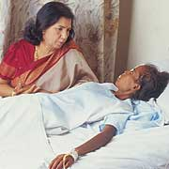
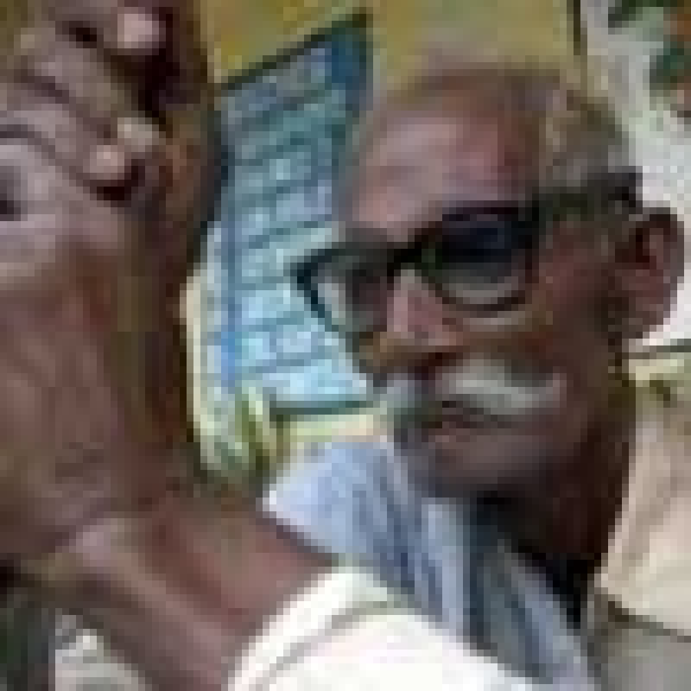
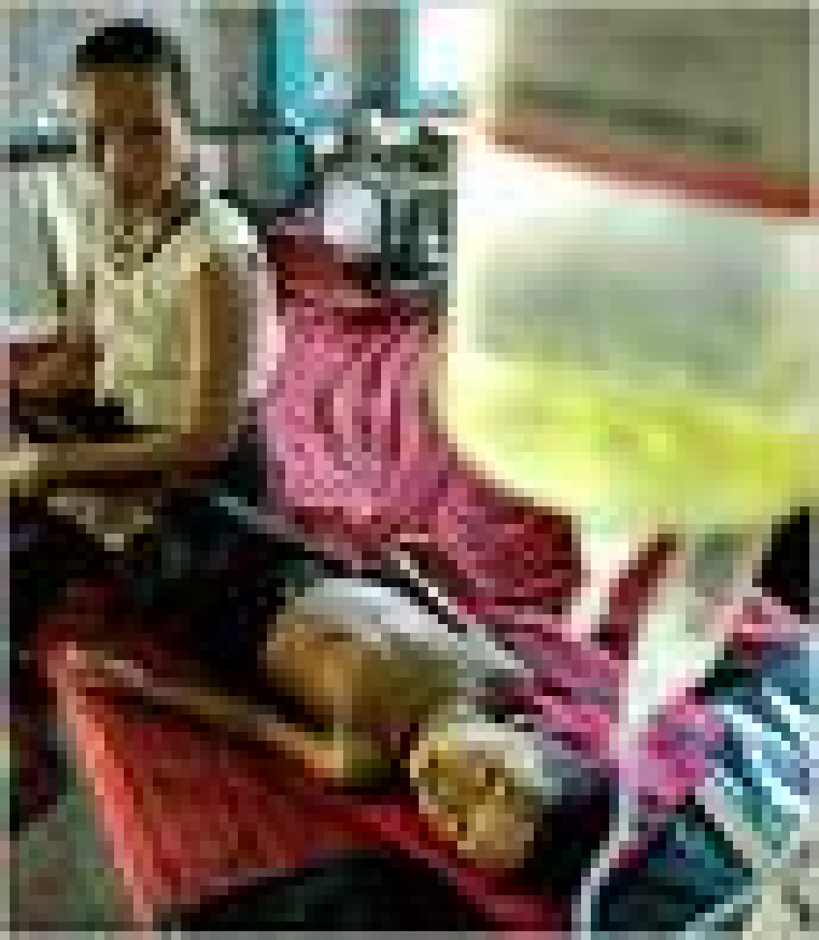
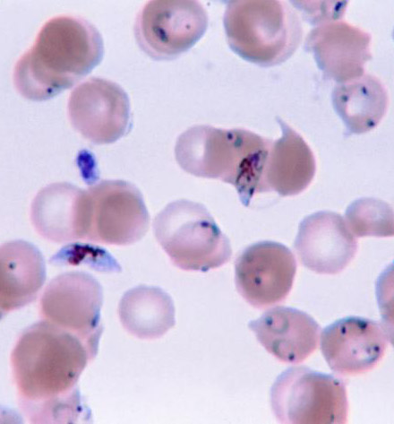

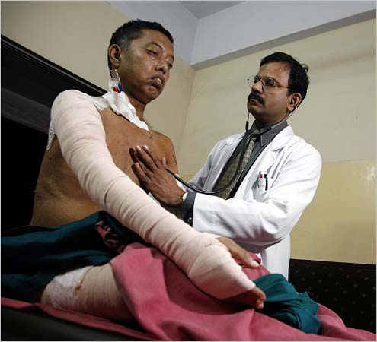
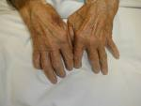
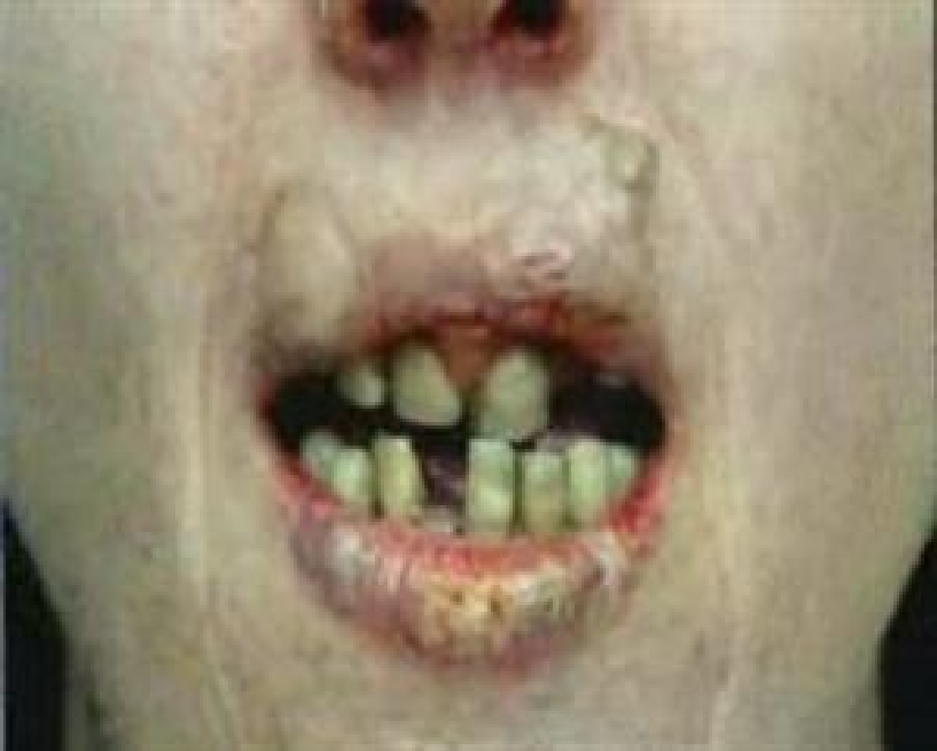
Vaccines yet to developed!
HIV/AIDS Patient Aging
Malaria-parasitic disease
Diabetes Rheumatoid arthritis
Smoking causes cancer

Slide 36
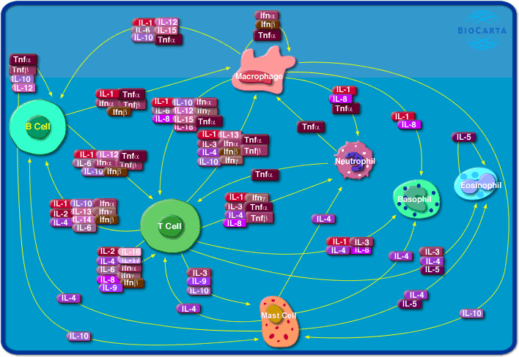
Immune Engineering
The complexity of the immune system can be compared to that of the brain.
There is a vast number of cells, molecules, and organs that compose the immune system, and these have to act in concert, and together with other vital systems, so as to promote and maintain life.
Neither can the immune system act in isolation to maintain life, nor can a higher organism live without an immune system.

Slide 37
Artificial immune systems (AIS) compose a new computational intelligence approach inspired by theoretical and experimental immunology with applications to problem solving.
Like all new approach, the field still lacks a more formal description and better theoretical foundations.
The application of mathematical analysis and modeling to immunology may result in outcomes such as a deeper and more quantitative description of how the immune system works, a more critical analysis of hypothesis, it can assist in the prediction of behaviors and the design of experiments.

Slide 38
Immuno-informatics
Epitope prediction tools

Slide 39
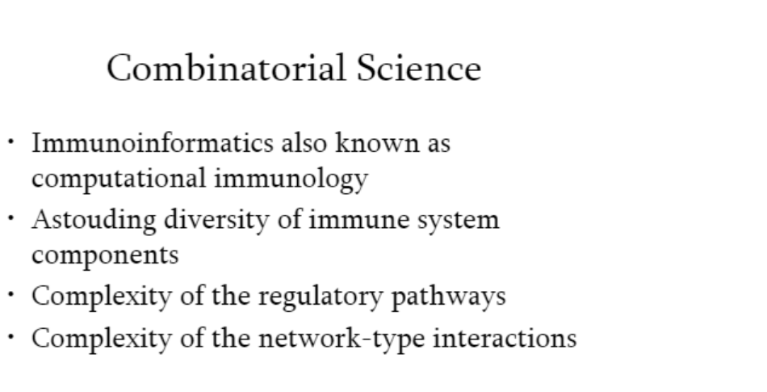

Slide 40
T-cell epitopes
T-cell epitopes are presented on the surface of an antigen-presenting cell (APC), where they are bound to major histocompatibility (MHC) molecules in order to induce immune response
MHC class I molecules usually present peptides between 8 and 11 amino acids in length, whereas the peptides binding to MHC class II may have length from 12 to 25 amino acids

Slide 41
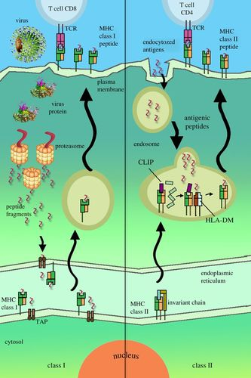

Slide 42
T cell Epitope Prediction Methods
Binding affinity predictions for a range of MHC molecules is considered to be the most popular epitope prediction methods.
Molecular binding between antigenic peptides and MHC molecules is necessary for recognition by cytotoxic T-cells.
The peptides with ability to bind MHC molecules could be predicted by different methodologies including Hidden Markov model (HMM), Artificial neural networks (ANNs), Support Vector Machine (SVM), and Quantitative matrices.

Slide 43
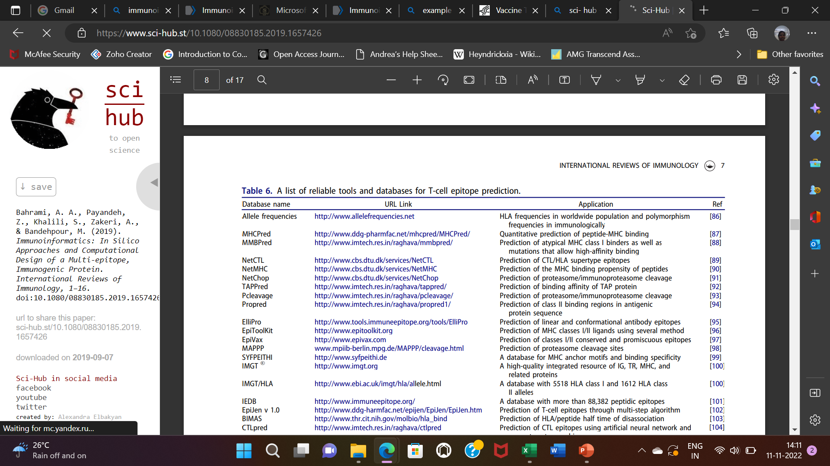

Slide 44
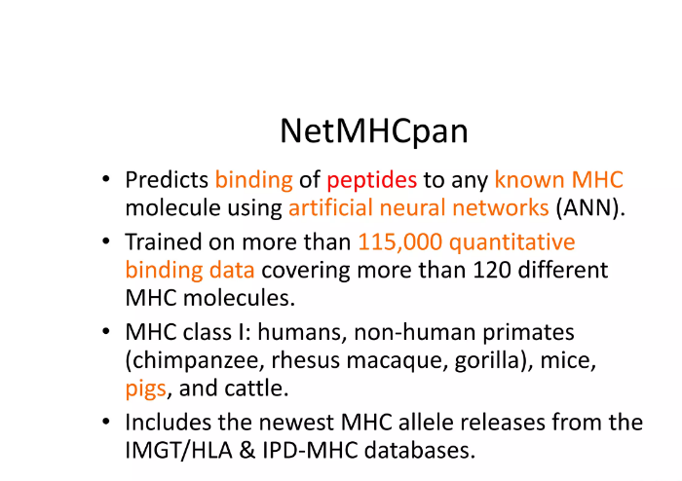

Slide 45
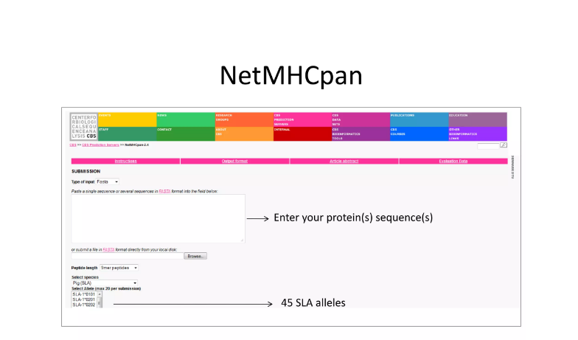
https://services.healthtech.dtu.dk/service.php?NetMHCpan-4.1

Slide 46
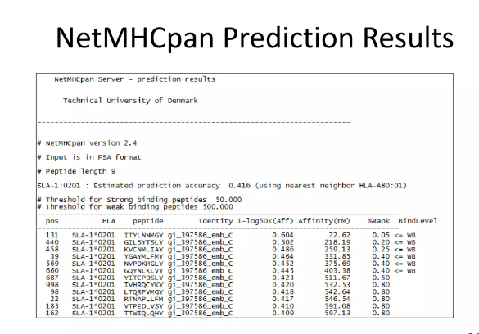

Slide 47
B-cell epitope prediction
Mapping B-cell epitopes within the protein sequence of antigens plays a crucial role in vaccine design, immunodiagnostic design and immunogen design for antibody production efforts
B-cell epitopes are determinant regions of the antigen with the ability to bind immunoglobulins and B-cell receptors (BCRs).
Identification of B-cell epitopes capable of invoking strong immune responses plays a pivotal role in effective vaccine designing efforts

Slide 48
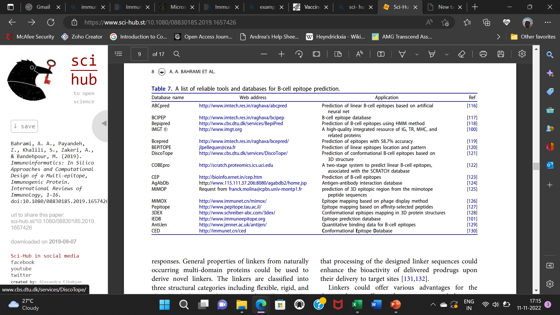

Slide 49
BepiPred
BepiPred-2.0 is based on a random forest algorithm trained on epitopes annotated from antibody-antigen protein structures.
This new method was found to outperform other available tools for sequence-based epitope prediction both on epitope data derived from solved 3D structures, and on a large collection of linear epitopes downloaded from the IEDB database

Slide 50
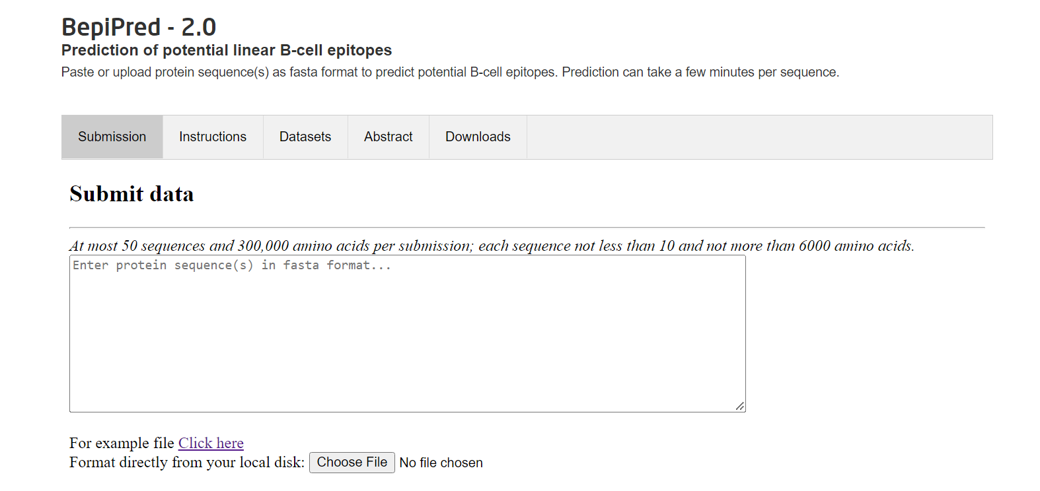
https://services.healthtech.dtu.dk/service.php?BepiPred-2.0

Slide 51
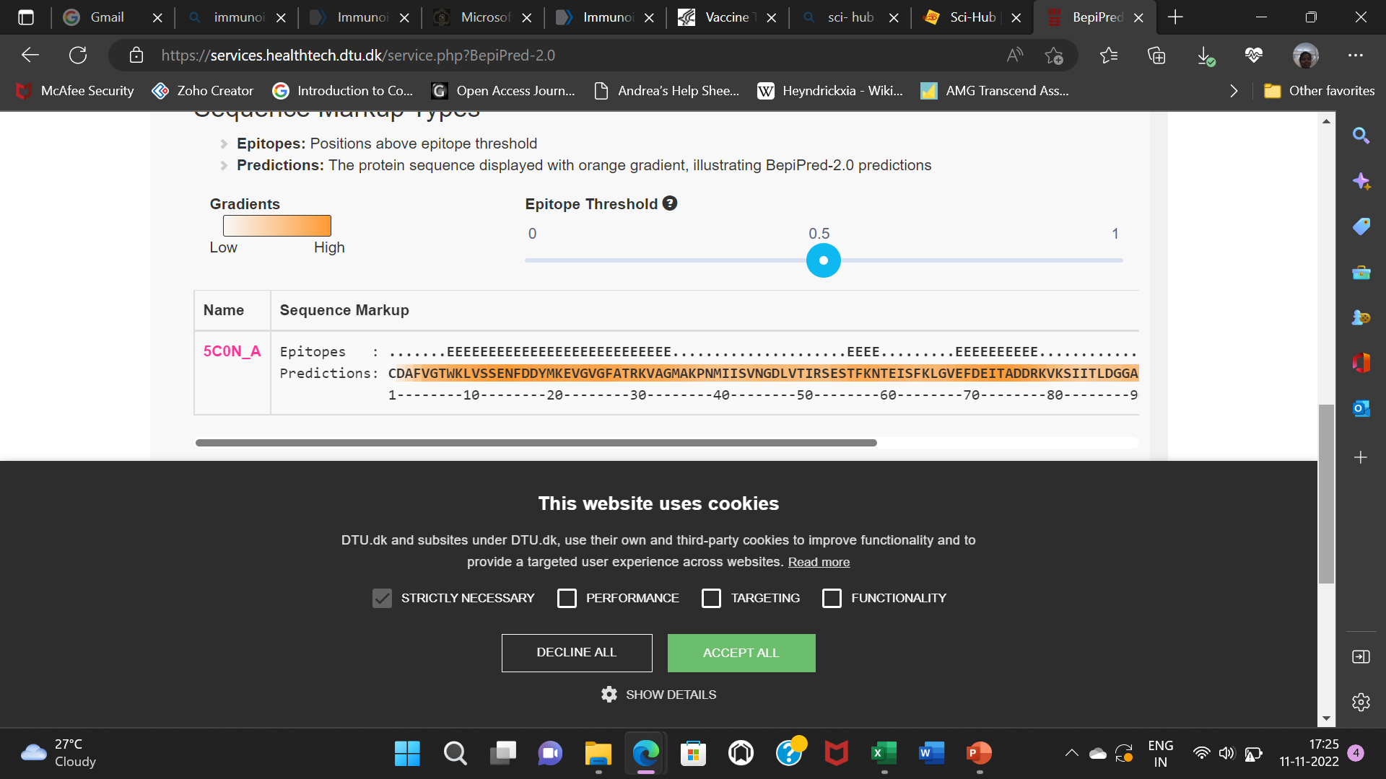

Slide 52
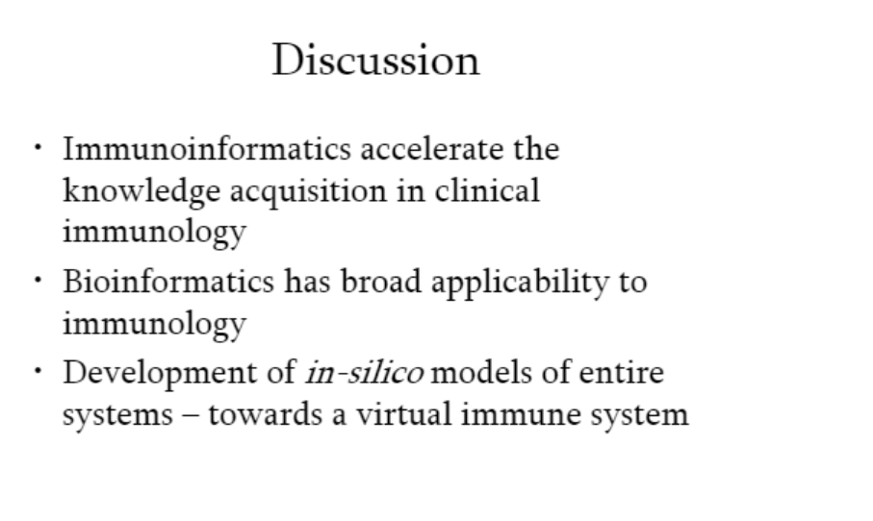

Slide 53
THANK YOU
Notes:
53

